Slide 1
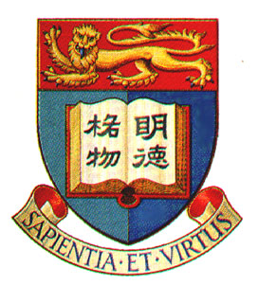

Science Update Programme
Liquid Crystals and Their Applications
Education Bureau, HKSAR
Department of Chemistry
University of Hong Kong
May 2002

Slide 2
References
P. J. Collings “Liquid Crystals: Nature’s Delicate Phase of Matter” Princeton University Press, Princeton, 1990.
P. J. Collings and M. Hird “Introduction to Liquid Crystals Chemistry and Physics” Taylor& Francis, London, 1997.
“Handbook of Liquid Crystal Research” P. J. Collings and J. S. Patel Eds., Oxford University Press, New York, 1997.
S.-T. Wu and D.-K. Yang “Reflective Liquid Crystal Displays” Wiley, New York, 2001.
Resources for more information about liquid crystals:
http://webphysics.davidson.edu/Alumni/BeDenius/liqcry/sourcepg.htm

Slide 3
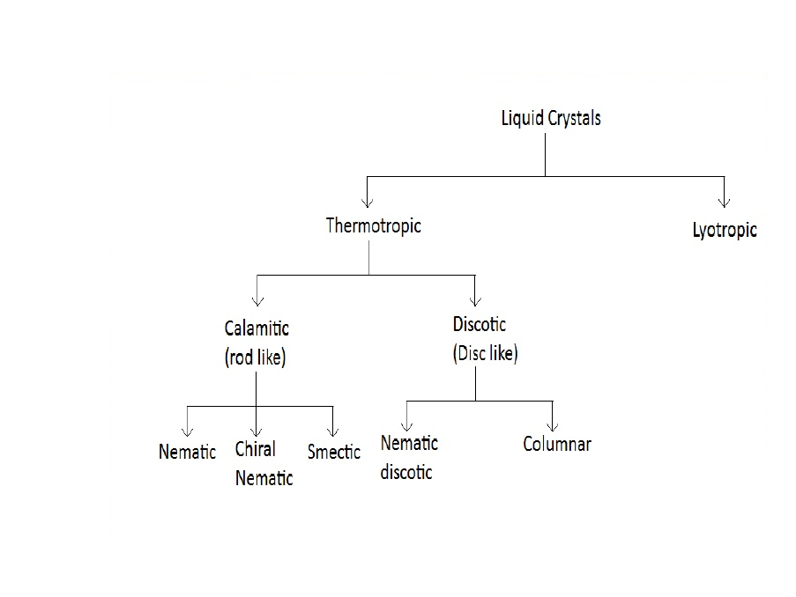
Classification of Liquid Crystals

Slide 4
What is Liquid Crystal?
Solid Phase
Molecules with both orientation and positional orders, and are held to each other strongly
Liquid Phase
Molecules with no orientation and positional orders, but are held together by weak intermolecular forces
Gas Phase
No ordering, no intermolecular attraction

Slide 5
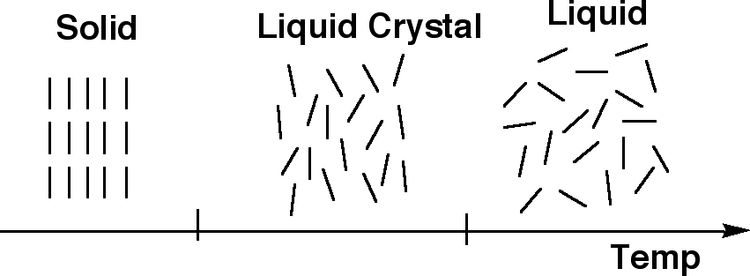
Liquid Crystal Phase
A fluid phase in which a liquid crystal flows and will take the shape of its container. It differs from liquid that there are still some orientational order possessed by the molecules

Slide 6
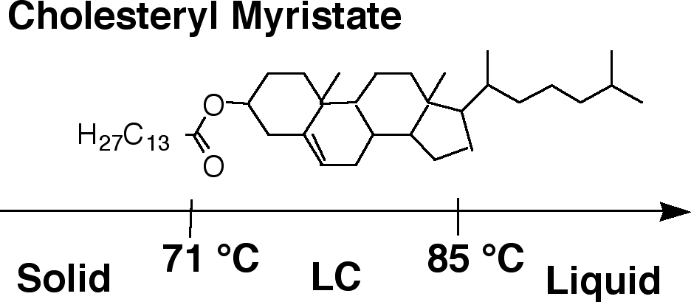
A phase that exists between solid and liquid
Discovered in 19th century when studying a cholesterol derivative

Slide 7
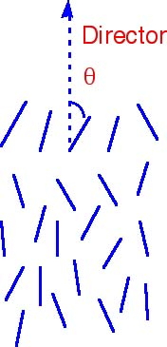
Orientational Order
Assuming that the direction of preferred orientation in a liquid crystal (LC) is ↑, this direction can be represented by an arrow, called the director of the LC.

Slide 8
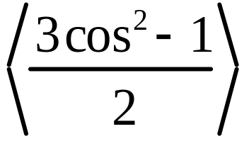
Each molecule is orientated at some angle to the director
We could measure all the angles and obtain the average angle as a measure of the degree of orientational order, which increases as θ → 0.
Order parameter (OD):
Perfect orientation: θ for all molecules = 0°, OD = 1
Completely random orientation: OD = 0

Slide 9
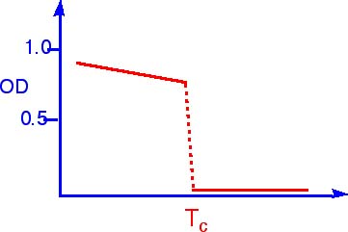
The order parameter decreases as the temperature is increased
Typical values of OD are ~ 0.3 to 0.9
Temp.
T_{c}: transition temperature from LC to liquid state

Slide 10
Criteria for a molecule being liquid crystalline
The molecule must be elongated in shape-length should be significantly greater than its width
Molecule must have some rigidity in its central region
The ends of the molecule are somewhat flexible

Slide 11
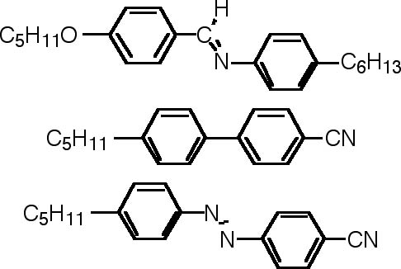
Typical representation of a LC molecule
Mesogens
Note: these molecules possess very strong dipole moment

Slide 12
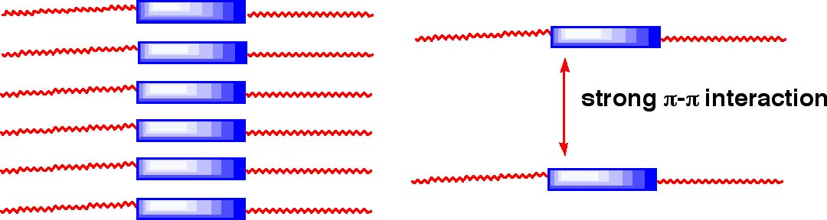
The liquid crystal molecules prefer to align parallel to each other because of the strong intermolecular attraction (π-π interaction)
Those LC exhibited by these rod-like molecules with one molecular axis much longer than the other two are called calamitic liquid crystals

Slide 13
Types of Liquid Crystals
Thermotropic Liquid Crystals
LC phase transitions resulted from temperature changes
Lytropic Liquid Crystals
LC phase is formed when a molecule is dissolved in a suitable solvent (with specific concentration at a particular temperature)

Slide 14
Different Liquid Crystal Phases
(Mesophases)
Nematic Liquid Crystal
Derived from a Greek word for thread
The simplest LC phase
The molecules maintain a preferred orientational direction as they diffuse throughout the sample (in a fluid phase)

Slide 15
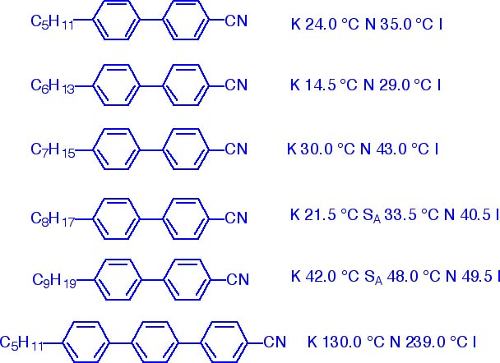
Transition temperatures of some alkylcyanobiphenyl homologues
K: Crystalline phase
N: Nematic liquid crystal phase
S_{A}: Smectic A liquid crystal phase
I: Isotropic phase (liquid phase)

Slide 16
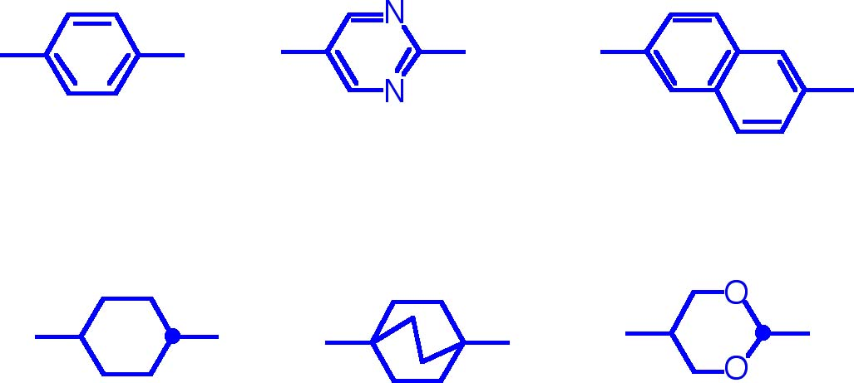
Other examples of core structures
1,4-phenyl
2,5-pyrimidinyl
2,6-naphthyl
trans-1,4-cyclohexyl
1,4-bicyclo[2.2.2]octyl
trans-2,6-decalinyl

Slide 17
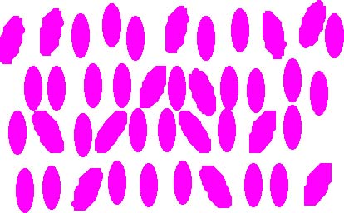
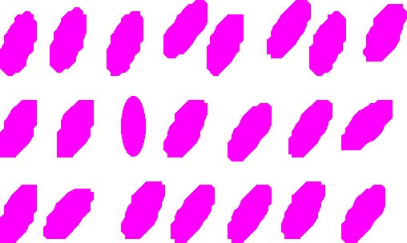
Smectic Phase
Besides orientation order, there also some positional order present in this phase
Smectic A to K phases have been discovered
θ
Smectic A phase:
Director perpendicular to the plane
Smectic C phase:
director makes an angle with the plane

Slide 18
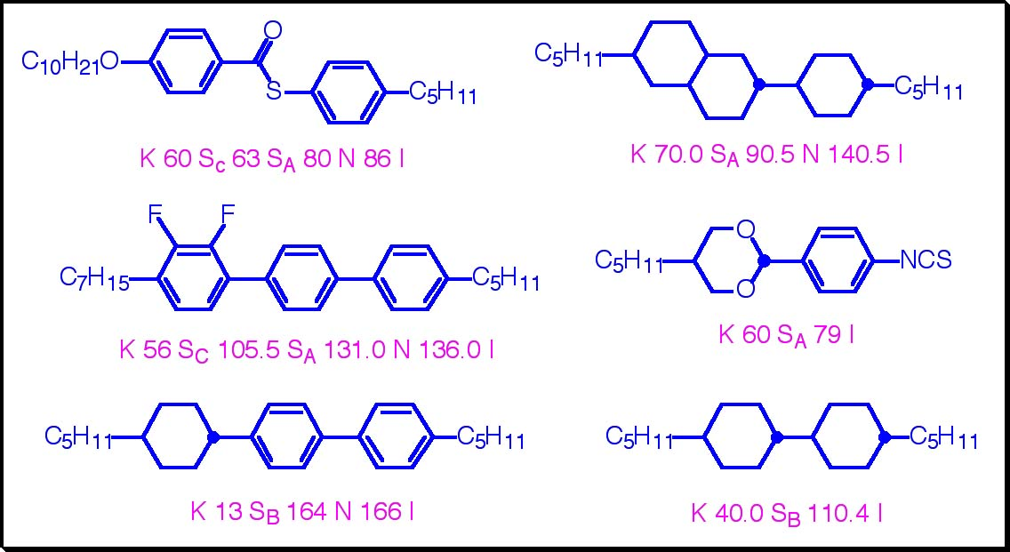
Other smectic LC phases exist in which the molecules exhibit orders within each plane
Many molecules exhibit more than one LC phases

Slide 19
Possible thermal transitions between different LC phases
Crystalline Solid
(Long range ordering)
Smectic Liquid Crystal
(Layer ordering)
Isotropic Liquid
(Random ordering)
Nematic Liquid Crystal
(Orientational ordering)

Slide 20
Cholesteric Liquid Crystal
(Chiral Nematic Phase)
Molecules with intermolecular forces that favor alignment between molecules at a slight angle to one another
The director is not fixed in space as in a nematic phase, it rotates throughout the sample

Slide 21
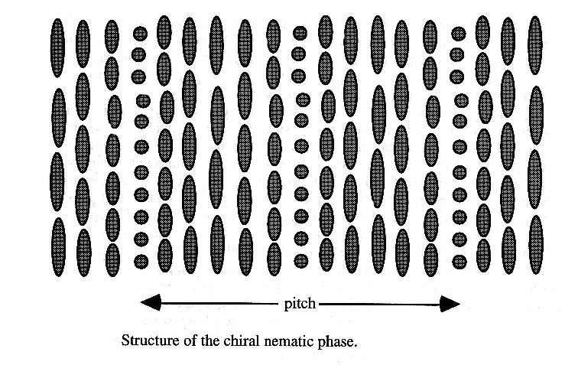
Structure of a chiral nematic phase
The director rotates about a horizontal axis. The distance for one full rotation is called a pitch.

Slide 22
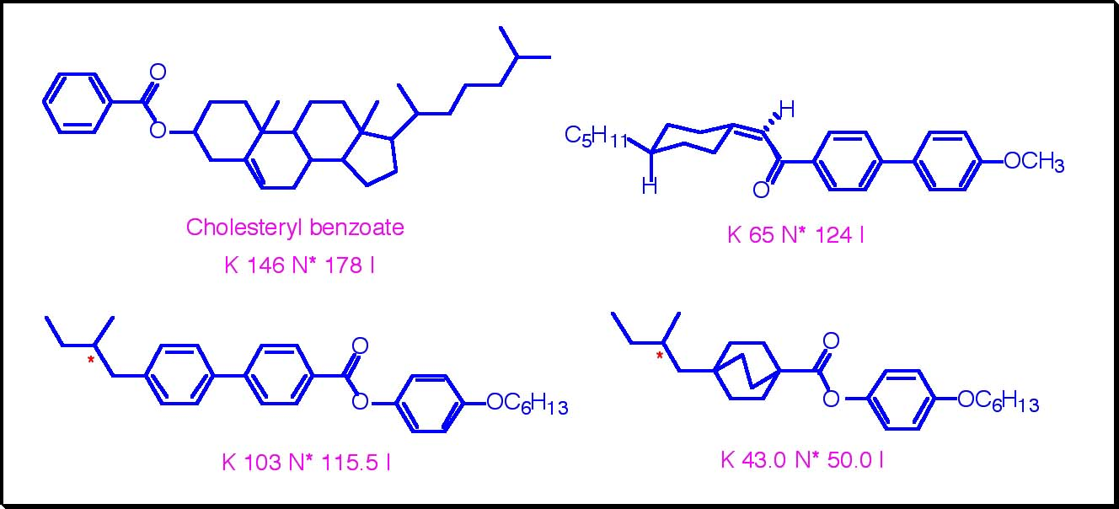
Examples of some molecules with chiral nematic phase

Slide 23
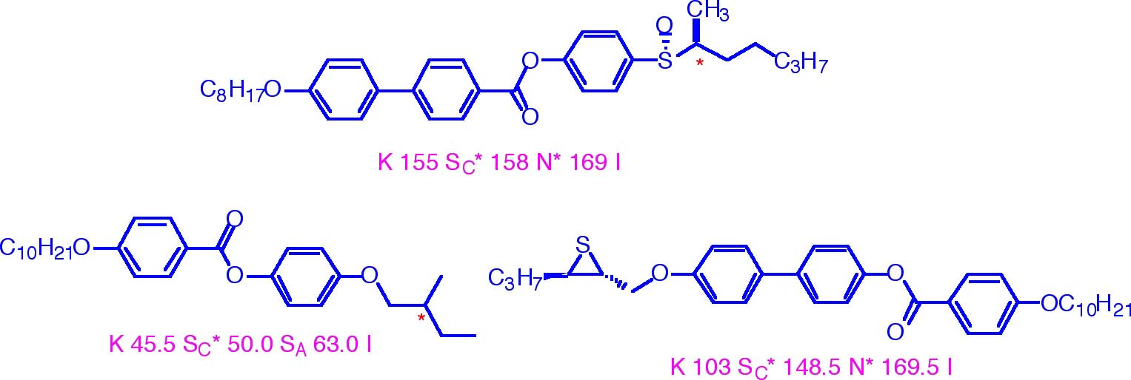
Some with both smectic and chiral nematic phases:

Slide 24
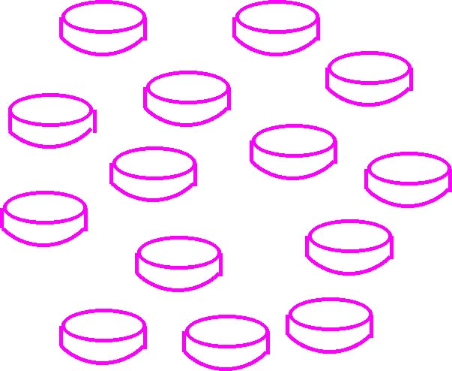
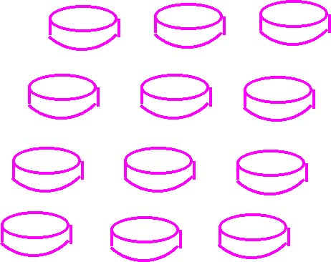
Discotic Liquid Crystals
Disc-like molecules
The axis perpendicular to the molecules tends to orient along a specific direction
Columar discotic
(smectic discotic)
The molecules tend to position themselves in column
nematic

Slide 25
In smectic discotic LC phase, the columns are arranged in a hexagonal or rectangular lattice (coins stacked in columns can be used to simulate the structures of various columnar mesophases.
Chiral nematic discotic LC phase also exists-the director rotates in a helical fashion
LC molecules: disc-shaped central core with some flexible peripheral moieties

Slide 26
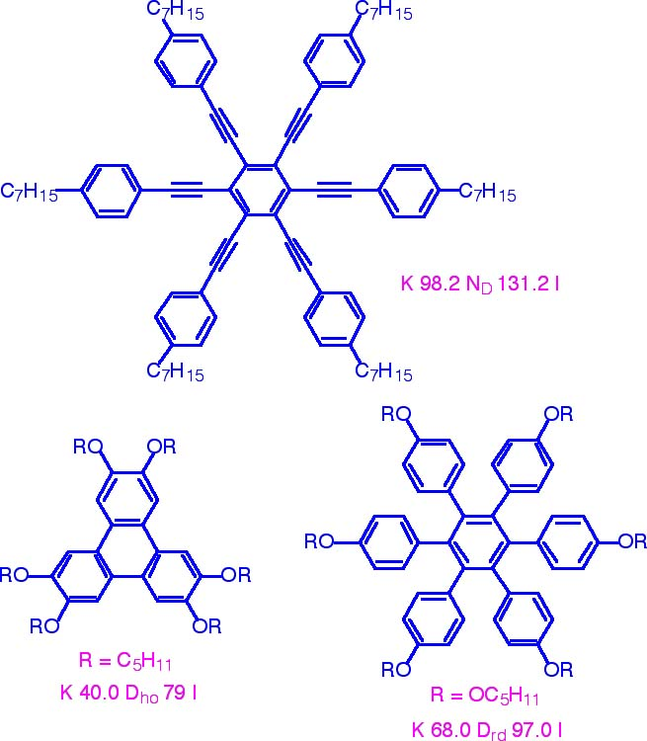

Slide 27
Lyotropic Liquid Crystals
When two different substances are mixed together, the mixture can exhibit different phases not only as the temperature is changed, but also as the concentration of one component of the mixture is varied.
Example: a molecule that has end groups with different properties (one is hydrophobic and the other is hydrophilic

Slide 28
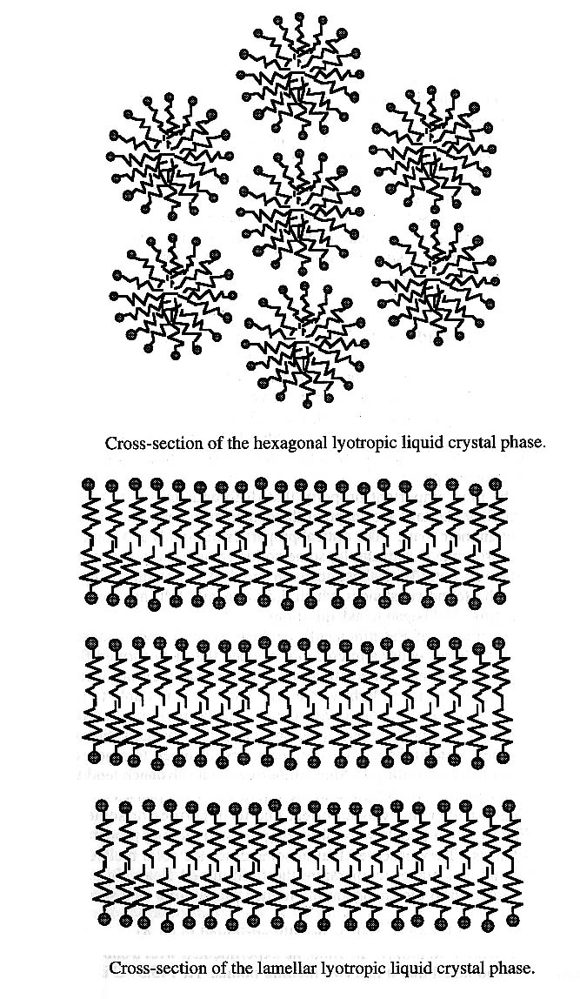

Slide 29
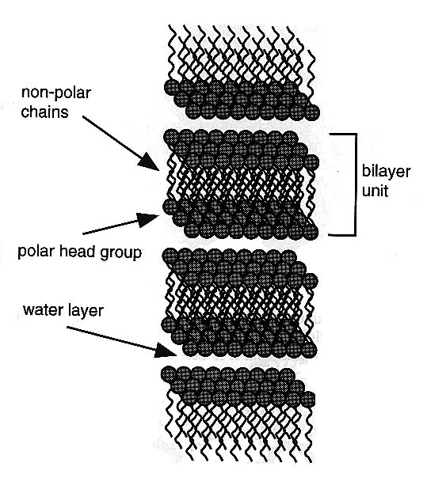
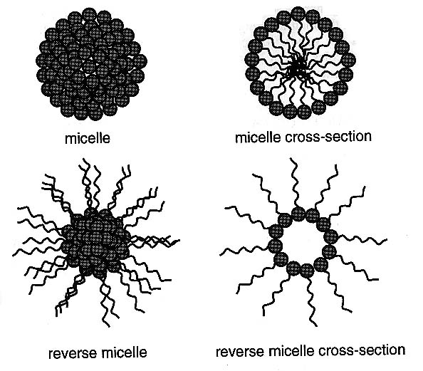

Slide 30
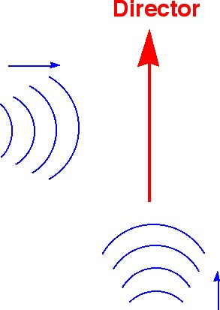
Anisotropy in Liquid Crystals
Liquid: isotropic physical properties
LC phases: the physical properties parallel or perpendicular to the director will be different
The speed of sound along these two directions will be different.
Therefore, LC phase is also called the anisotropic phase

Slide 31
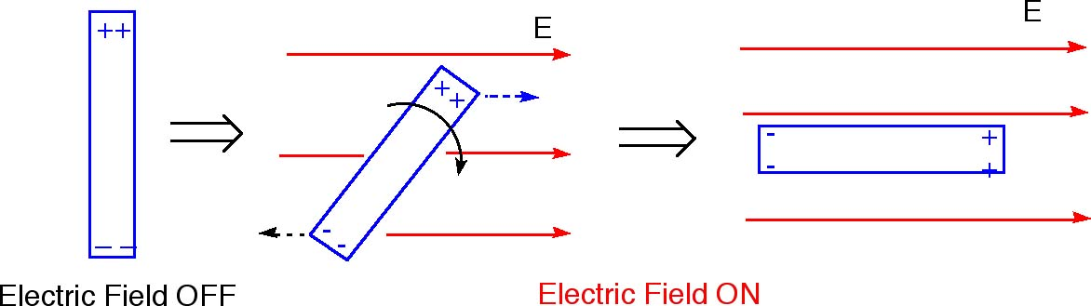
Effect of Electric Field
Many LC molecules possess permanent electric dipole
Under an electric field, the molecules tend to rotate until the positive and negative ends line up with the electric field

Slide 32
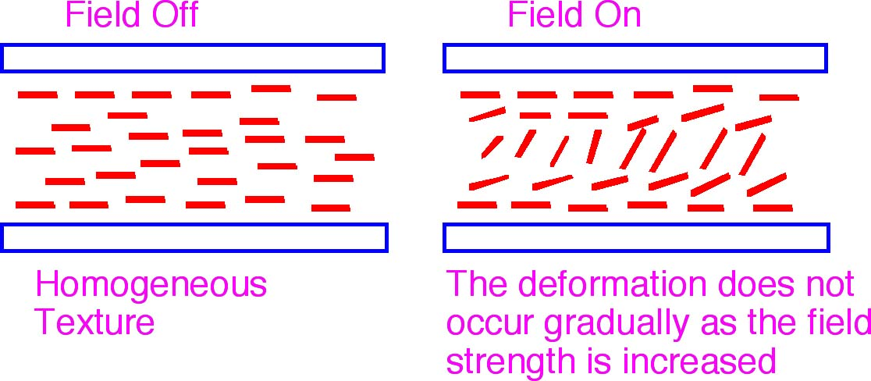
Effect of Surface
When dispersed on a substrate (e.g. glass slide, polymer film), the alignment of liquid crystal molecules can be controlled by pretreating the surface.

Slide 33
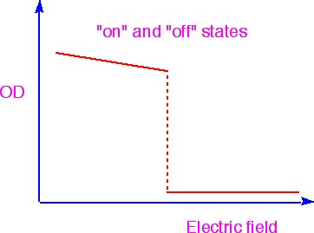
The deformation of molecular alignment does not occur gradually as the field strength is increased
For E-field below a threshold value, the molecules are almost completely undeformed.
Such transition is called Freedericksz Transition

Slide 34
Defect in Liquid Crystals
A normal, unaligned sample of a nematic LC does not usually have a director that points in the sample direction in all regions of the sample. The director changes throughout the sample and at positions where the director abruptly changes direction, no specific director can be defined, and a defect is generated.
The defects can be studied by polarized microscope

Slide 35
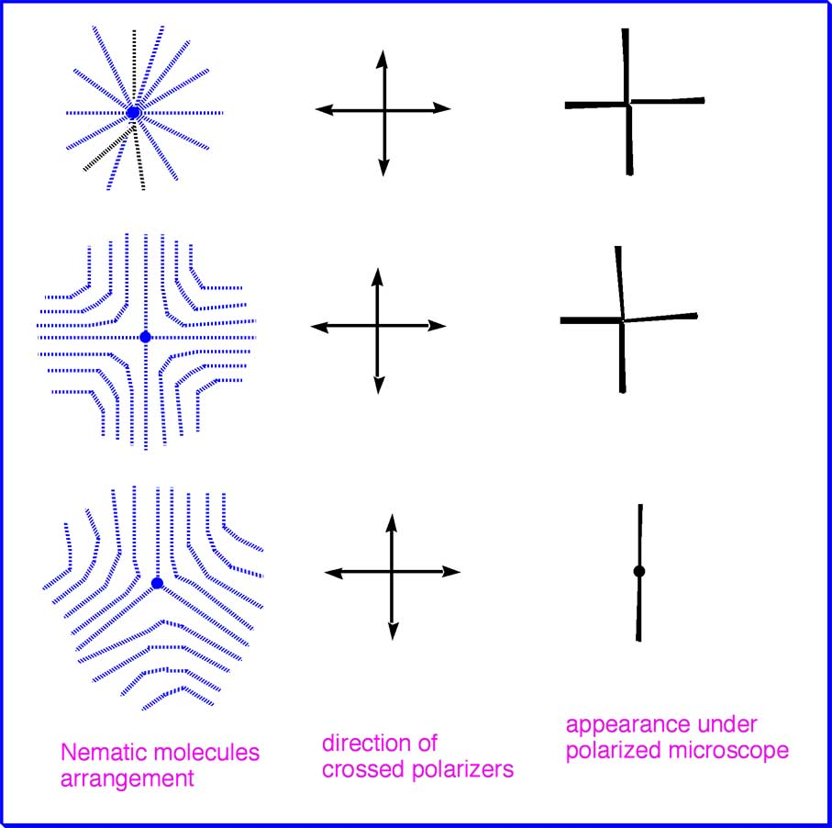

Slide 36
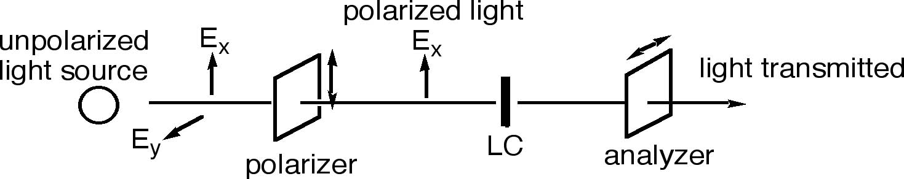
Interaction with Polarized Light
Since liquid crystals are anisotropic, they cause light polarized along the director to propagate at a different velocity than that polarized perpendicular to the director
The polarization of light is rotated by the LC molecules

Slide 37
If the polarized light incident on the LC has its polarization direction either parallel or perpendicular to the director, it will appear black under crossed polarizers
When viewed under a microscope with the sample between two crossed polarizers, the director usually points in different directions at different points within the sample
The specific textures observed under microscope give the information about the type of LC phase formed
For more information about liquid crystal phases and their optical textures, please see:
http://abalone.phys.cwru.edu/tutorial/enhanced/files/lc/phase/phase.htm

Slide 38
Other techniques that is commonly used in the characterization of Liquid Crystal phases
X-ray diffraction
  Structure of the LC phases
  Presence of long range order
Thermal analysis
  e.g. Differential Scanning Calorimetry (DSC)
  Transition temperatures
  Enthalpy of thermal transitions

Slide 39
Liquid Crystal Display (_x0008_LCD)
The simplest display device: with ON and OFF states only.
Make use of the change in brightness of the device (Black vs. White)
The simplest LC display:
twisted nematic mode
More information on LCD at:
http://abalone.cwru.edu/tutorial/enhanced/files/lcd/tn/tn.htm

Slide 40
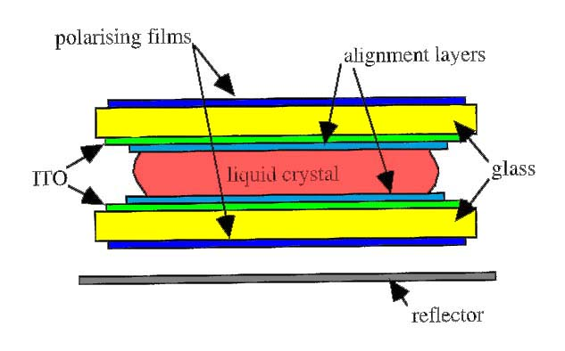
The glass surfaces have been treated so that the LC molecules prefer to align parallel to the surface
The director of the nematic LC molecules is forces to twisted through an angle of 90° within the cell
(i.e. the polarization direction of light rotates 90°)

Slide 41
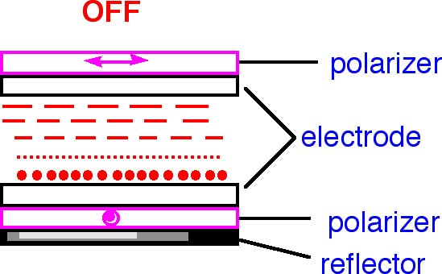
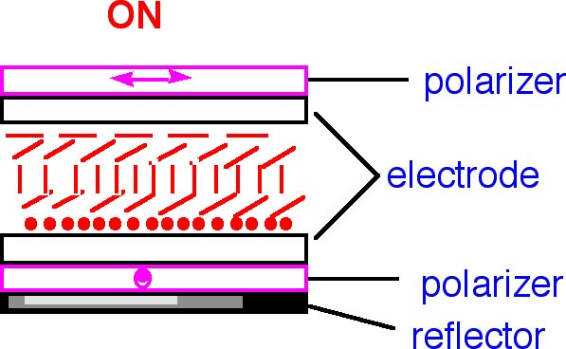
Polarized light can enter the second polarizer and it is reflected back to the surface
Polarized light cannot enter the second polarizer. No light is reflected. A dark surface is observed.
×

Slide 42
Multicolor Display
Typically found in all laptop computers/TVs/PDAs
Every pixel contains three color components-Red, Green, and Blue

Slide 43
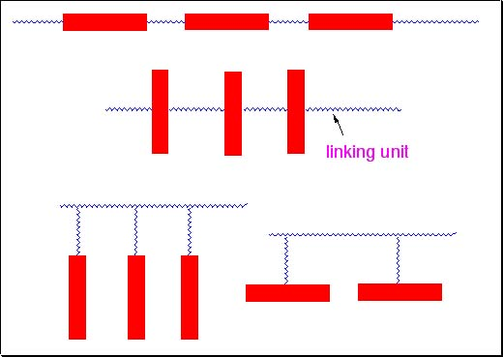
Polymer Liquid Crystals
The mesogenic unit is incorporated into a polymer molecule
On the main chain or side chain

Slide 44
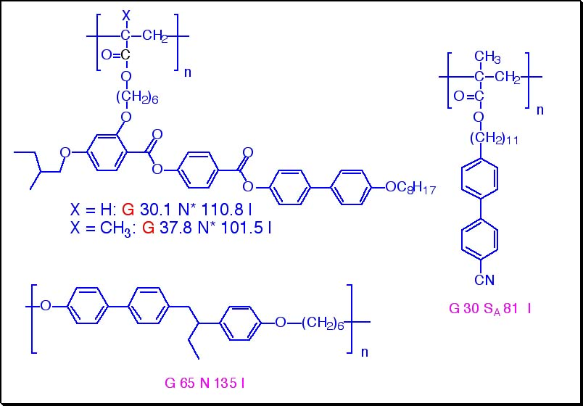

Slide 45
Applications of Liquid Crystals
Surface Thermometry
  Thermochromic behavior of chiral nematic phase
Switchable Light Panels (windows)
  Liquid crystal droplets dispersed in a polymer film, whose optical properties change under the action of an electric field

Slide 46
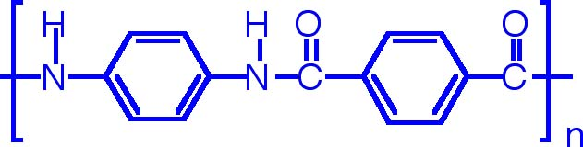
Spinning of fibers from polymers
  Some aromatic polyamides form lyotropic LC phase when dissolved in suitable solvents.
  When fibers are spun from LC solution, the molecules will have additional ordering in alignment, which give enhanced tensile strength to the fibers
  Example: Kevlar
    This polymer forms lyotropic LC solution in sulfuric acid

